Slide 1
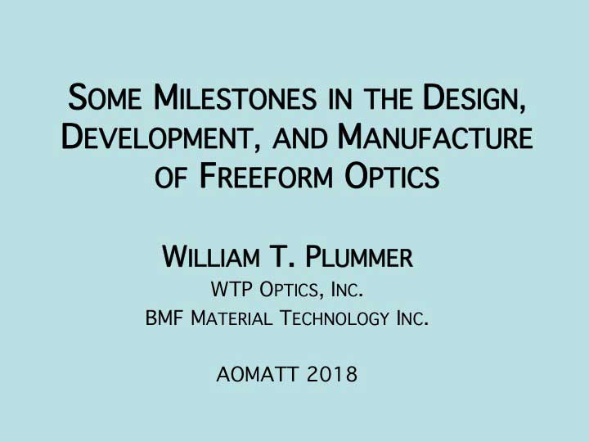

Slide 2
Notes:
2. The earliest freeform optical surfaces were conceived for progressive spectacle lenses.

Slide 3
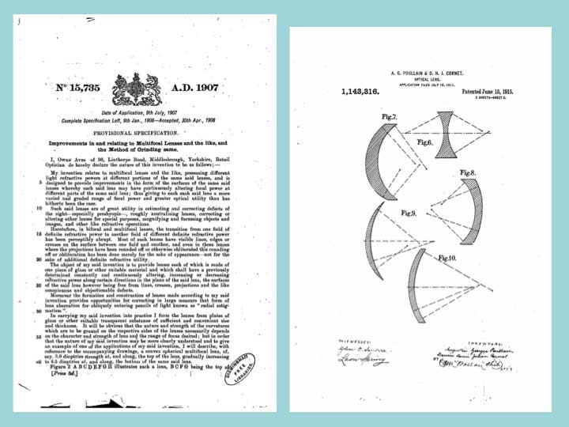
Notes:
3. Freeform optical surfaces, made without rotational symmetry of any kind, were considered more than 100 years ago for use on spectacle lenses. Here are early patents by Aves in England (1908) and Poulain and Cornet in France (1915).

Slide 4
Notes:
4. Many years passed before freeform surfaces became available. Here are two patents by Evans in the USA, dated in 1938 and 1956, first proposing a freeform design and later a suggestion for manufacturing it. I don’t know whether these lenses were actually made

Slide 5
Notes:
5. In 1959 Clarence Kanolt described the mathematics useful for making a good image with a freeform spectacle lens, and disclosed that the freeform progressive surface and the prescription surface for correcting astigmatism could be combined on one side of the lens.

Slide 6
Notes:
.6. Also about 1959 Maitenaz in France designed the first commercially successful freeform spectacles, called Varilux.

Slide 7
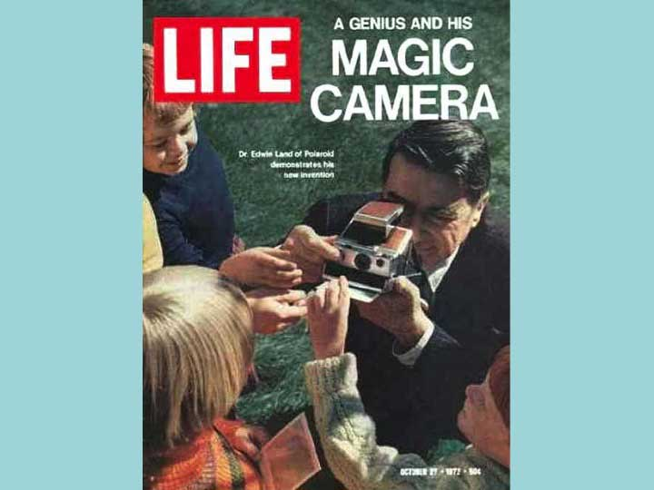
Notes:
7. I joined the Polaroid corporation in 1969, and helped design the SX-70 camera. It was introduced to the public in 1972 by Edwin Land, shown here on a LIFE magazine cover dated October 27.

Slide 8
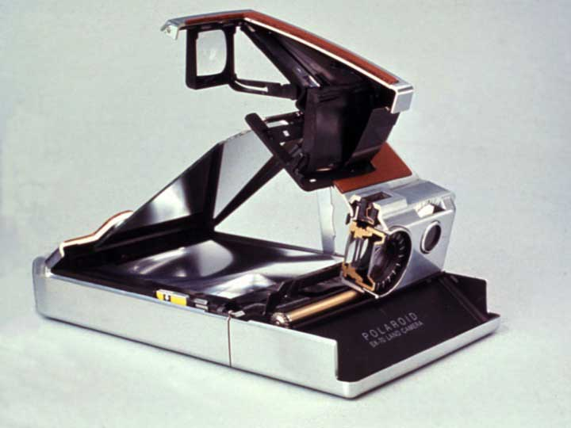
Notes:
8. The Polaroid SX-70 camera, shown cut away, was a single-lens-reflex. The photographer saw the scene and composed his picture while looking through the lens of the camera itself. After the original application for eyeglasses, this camera was the first commercial product that made use of freeform optical surfaces.

Slide 9
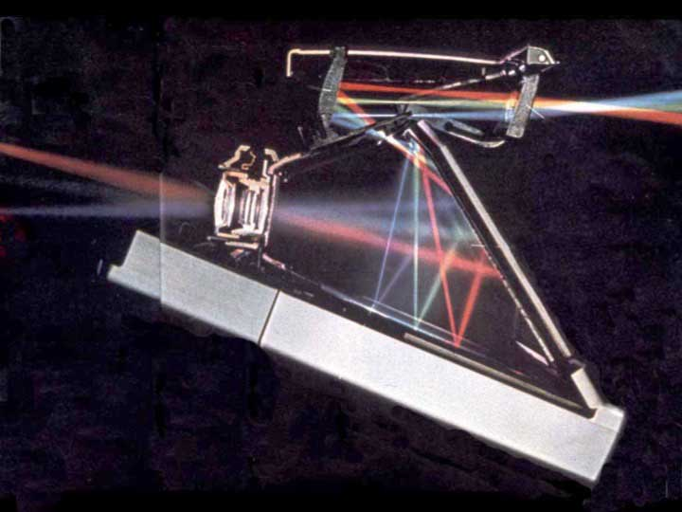
Notes:
9. Here is a cross section photograph of the SX-70 camera, showing three colors of light passing through all of the viewing optics. Light coming from three different directions in a scene -- high, middle, and low -- passes through the picture taking lens on the left. It all reflects from a flat mirror, and then forms three separate images on the focus screen at the bottom. The focus screen is a reflecting Fresnel mirror that brings the three colors together again, reflects them once more from the flat mirror, and directs all of them out of the camera body through one small hole, an aperture stop, near the top of the mirror. Then the three colors spread apart, reflect from a molded concave mirror, and form three separated images in the air. The three colors continue into a molded eye lens, and are brought together again where they reach the photographer’s eye. The photographer sees the three color images as they appear in space in front of the camera -- high, middle, and low -- just as they will appear in the photograph.

Slide 10
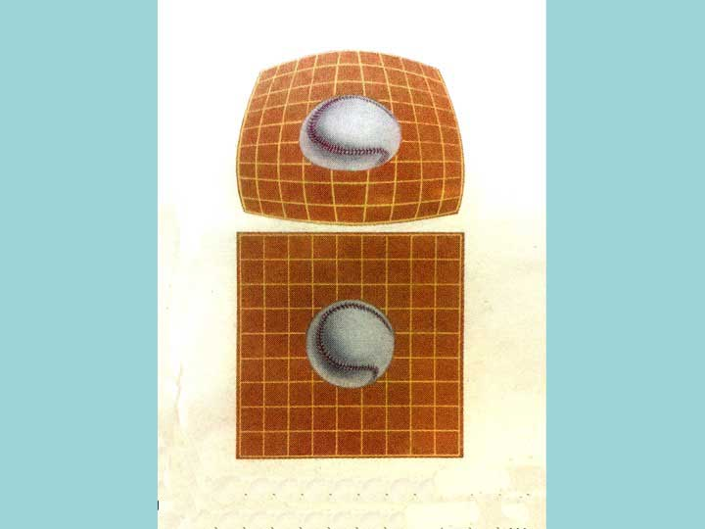
Notes:
10. If the concave mirror were made with a usual spherical surface, the view of the square image area would appear distorted, squeezed out of shape as shown here. To correct the appearance to a square, the concave mirror is designed with a non-spherical shape, becoming flatter toward the top.

Slide 11
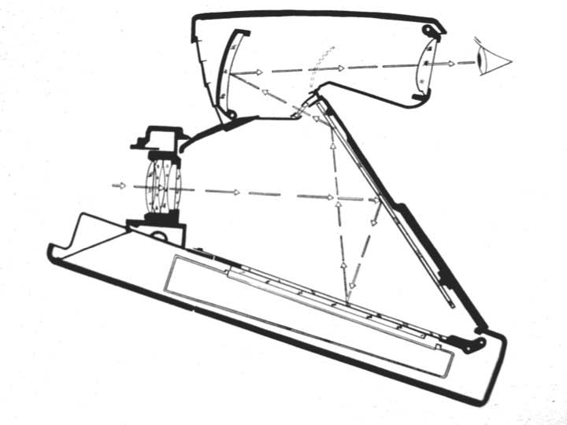
Notes:
11. This diagram shows the path of light through the optics by little arrows. When we made the concave mirror flatter toward its top, the image of the scene formed in the air became tilted, shown by the dotted shape in the space between the concave mirror and the eye lens. As a result it formed closer to the eye lens at the top, and the eye saw it as very near. The bottom of the image appeared to be distant. A photographer with presbyopia could not see all of the image area clearly. This is the same problem that is solved in a spectacle lens with a bifocal addition, or with a progressive freeform shape. For the SX-70 camera I solved this problem by putting a freeform shape on the flatter side of the eye lens.

Slide 12
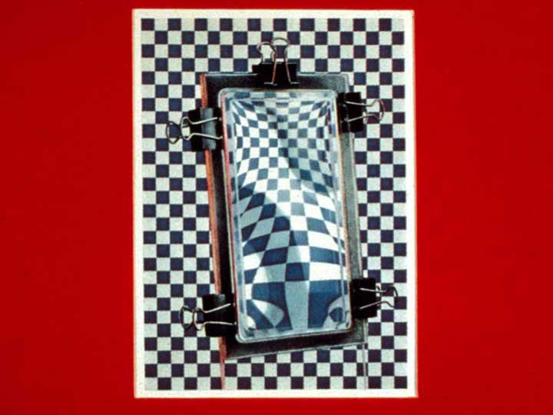
Notes:
12. To explain what a freeform shape is I made a little demonstration, a flat plastic window with a thin plastic kitchen membrane stretched across it and held at the edges. I put water in it, and tilted it to show that it would make a kind of lens with both concave and convex shapes. This shape has no axis of rotational symmetry and cannot be generated on a lathe.

Slide 13
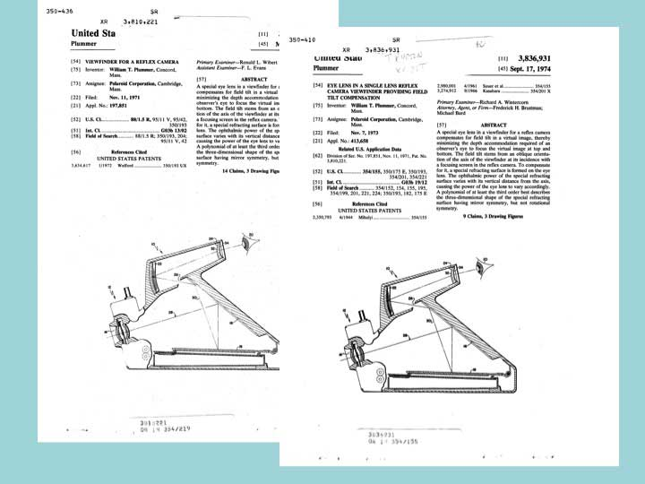
Notes:
13. Here are two patents from 1974, showing where the freeform shape could be used on the eye lens.

Slide 14
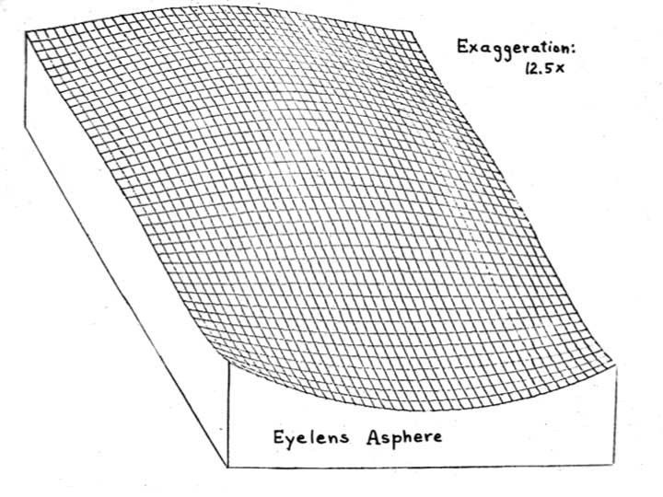
Notes:
14. This is the shape we used in the camera, with the height exaggerated to show its form. The size of this surface is about 2 centimeters square, a little smaller than a spectacle lens.

Slide 15
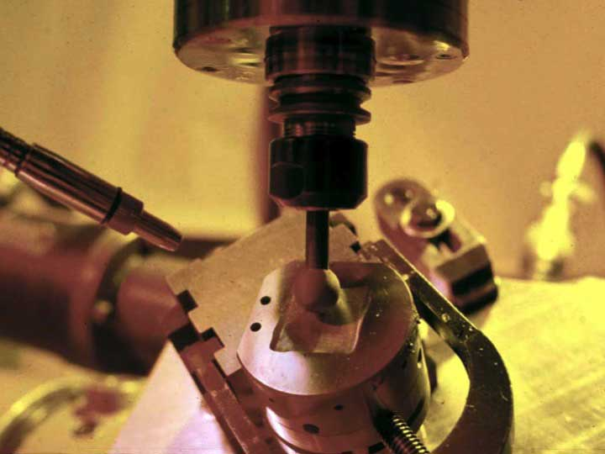
Notes:
15. We made the metal tooling for the eye lens shape by grinding it with a three-axis computer controlled machine. At that time, computer control required using a long punched paper tape.

Slide 16
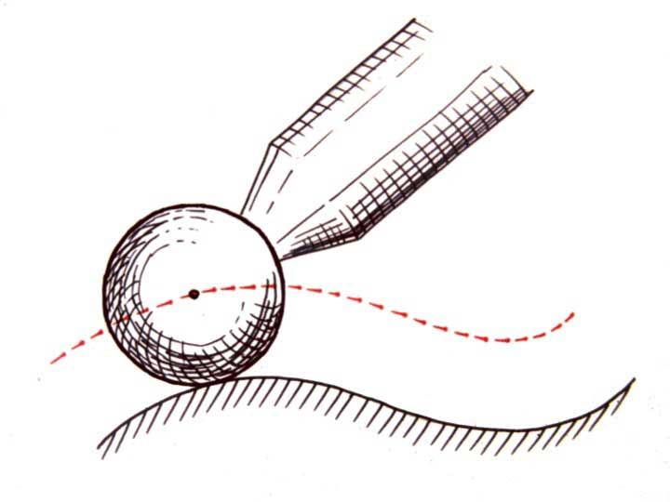
Notes:
16. When a surface is ground in this way, the path of the grinding tool is different from the shape of the lens surface, and has to be calculated. Where the ground surface is convex, the radius of the cutter is added to it to define the path, and where the ground surface is concave, the radius of the cutter is subtracted from it. Of course, this correction must be made in three dimensions.

Slide 17
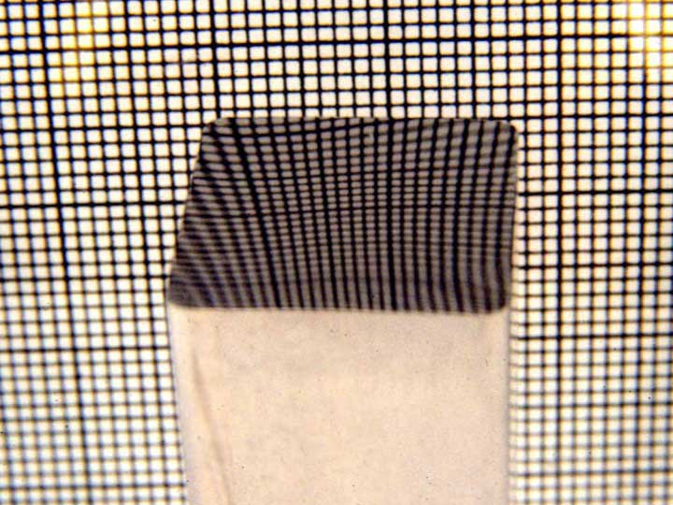
Notes:
17. Here is a finished molding tool made in this way, showing by reflection that it is a freeform surface. We started putting the freeform shape in the SX-70 camera in 1973.

Slide 18
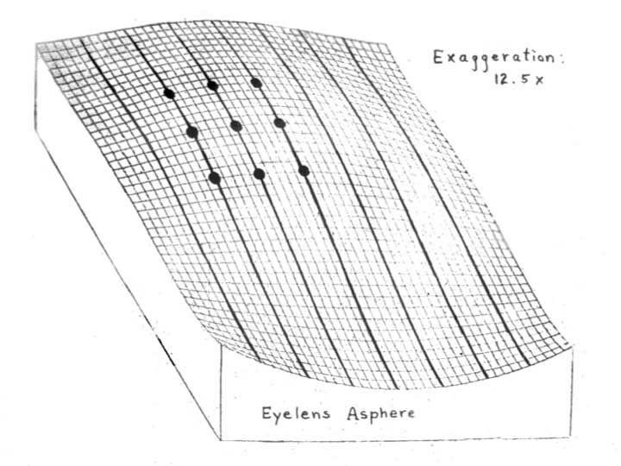
Notes:
18. To measure this freeform shape and control its quality we used a special profilometer to measure the molding tool and the molded lens along seven parallel paths, with a precision of about three millionths of an inch. That is only 76 nanometers. For our analysis we looked at the data in a moving group of nine points, shown here by the dark marks.

Slide 19
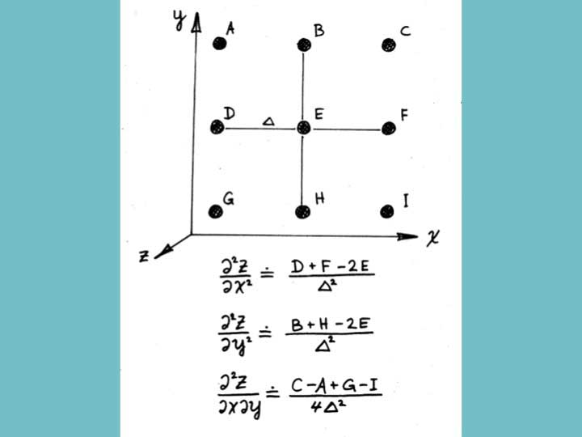
Notes:
19. In each group of nine measurements I found the local curvatures in this way, by calculating these three second derivatives of the surface shape.

Slide 20
Notes:
20. I used the formulas disclosed by Kanolt in his 1959 patent to express our surface quality in ophthalmic language, as a spherical error and a cylindrical error. In this way we made our camera lenses within ophthalmic tolerances.

Slide 21
Notes:
21. Our freeform eye lens shape gave us a new problem, however. Because of the changing power over the lens surface, the focus had to be a little different between the top and the bottom of the pupil of the eye. The concave mirror’s changing shape added to this problem, called “coma”, and we did not like the result. We corrected it by introducing another little lens right at the small aperture where the light all passes from the camera body into the viewfinder, just before the concave mirror. This new lens also has a freeform shape. Since this little lens is imaged onto the pupil of the eye, we can think of it as a virtual contact lens!

Slide 22
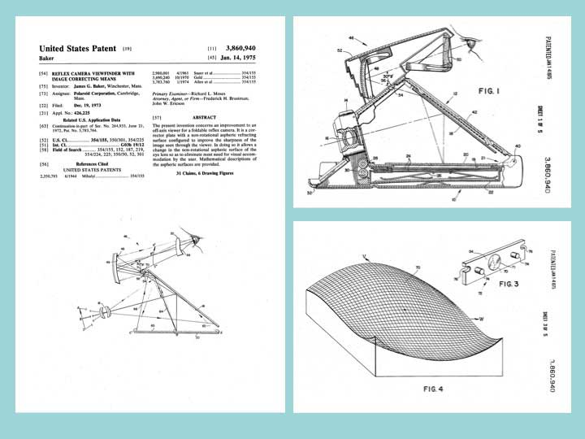
Notes:
22. Here is a patent for our final design, showing the shape of that little lens that corrects the coma. The lens diameter is about 4 millimeters.

Slide 23
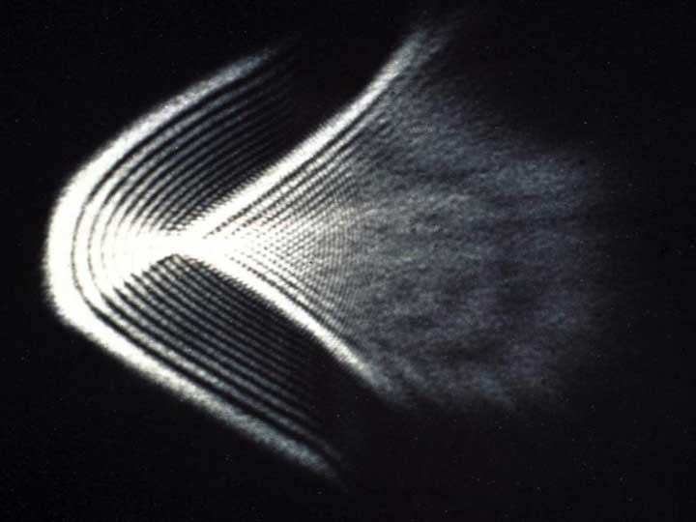
Notes:
23. This pretty photo shows how a simple laser beam is spread by the small freeform lens.

Slide 24
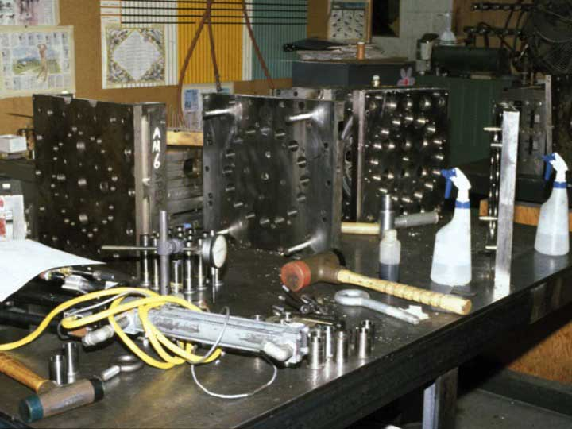
Notes:
24. These are the parts of the injection mold for manufacturing the eye lens. They are quite heavy, and are shown here on a very strong table.

Slide 25
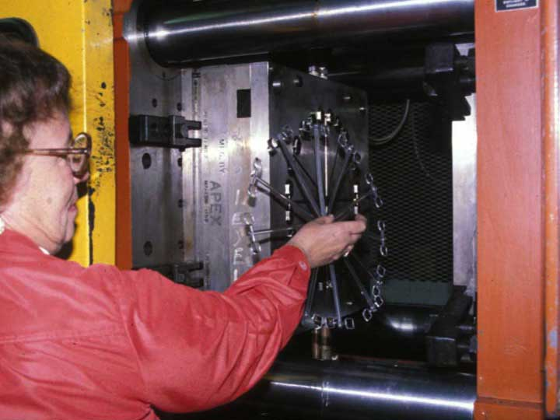
Notes:
25. The eye lenses were molded 24 at a time, the small corrector lenses were molded twelve at a time, the concave mirrors were molded 32 at a time, and all of these parts were already polished when they were taken out of the machine.

Slide 26
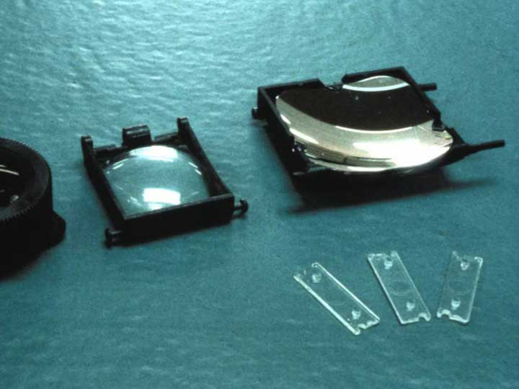
Notes:
26. Here are the viewing optical parts from the SX-70 camera: a mounted freeform eye lens, a mounted concave mirror, and three samples of the small freeform coma correcting lens.

Slide 27
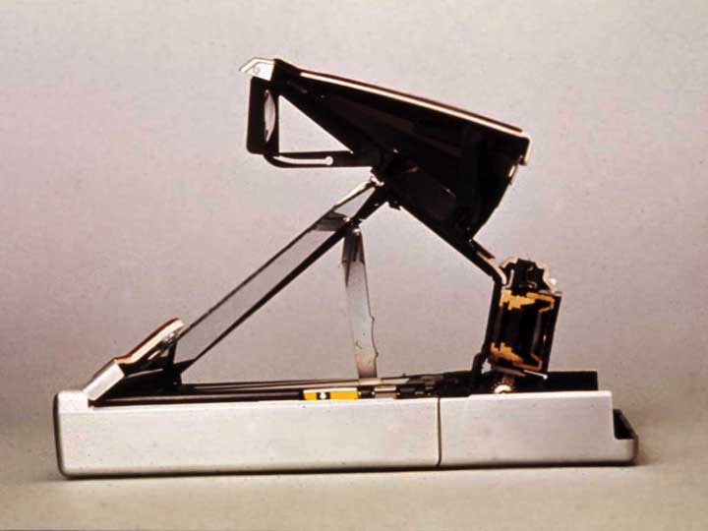
Notes:
27. Another cut away view shows the camera as it is used to take a picture.

Slide 28
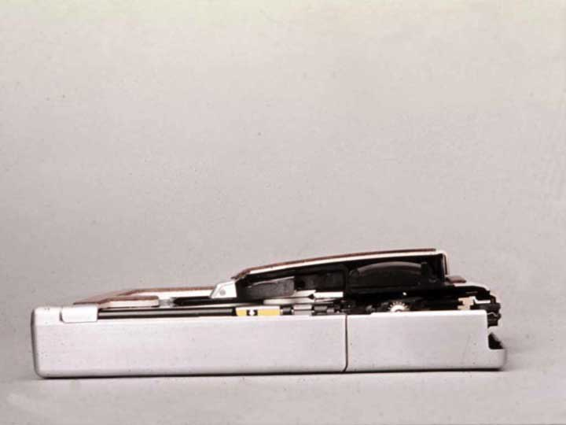
Notes:
28. This view shows that the camera can be folded flat to carry in a pocket.

Slide 29
Notes:
29. We realized that the first freeform surface we used on the SX-70 camera could also be turned upside down and used on a spectacle lens, and could be combined with other prescription requirements onto just the concave side of the lens, leaving the convex side spherical.

Slide 30
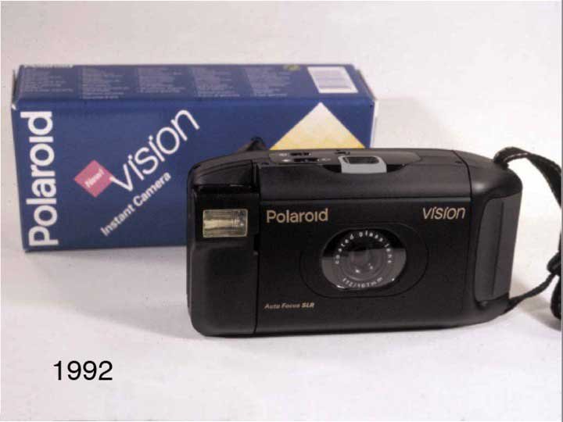
Notes:
30. We used freeform shapes again in another camera, called Vision, in 1992.

Slide 31
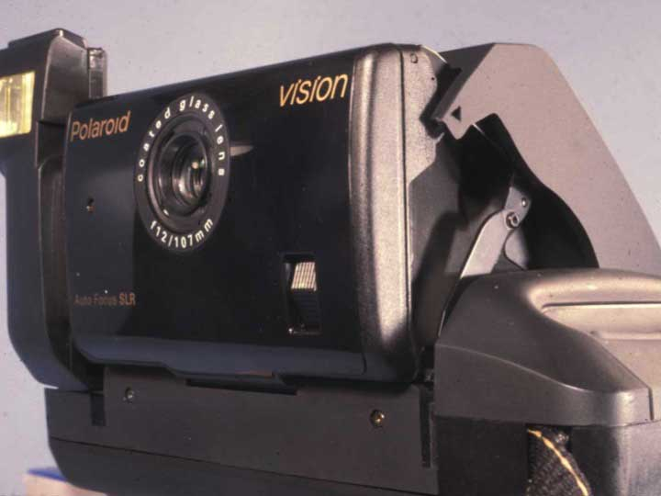
Notes:
31. This newer camera was also a single lens reflex, but the optics were different. This camera had an interesting mechanical structure that used a six-bar linkage, seen here on the right, to unfold three sections in sequence as it was opened.

Slide 32
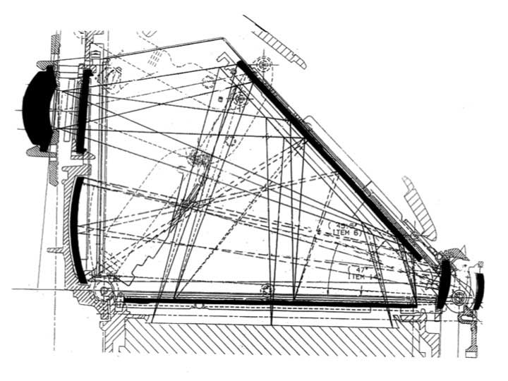
Notes:
32. The folded optical path did not have room for the small coma correcting lens. Instead, we used a freeform shape for the concave mirror as well as for an eye lens

Slide 33
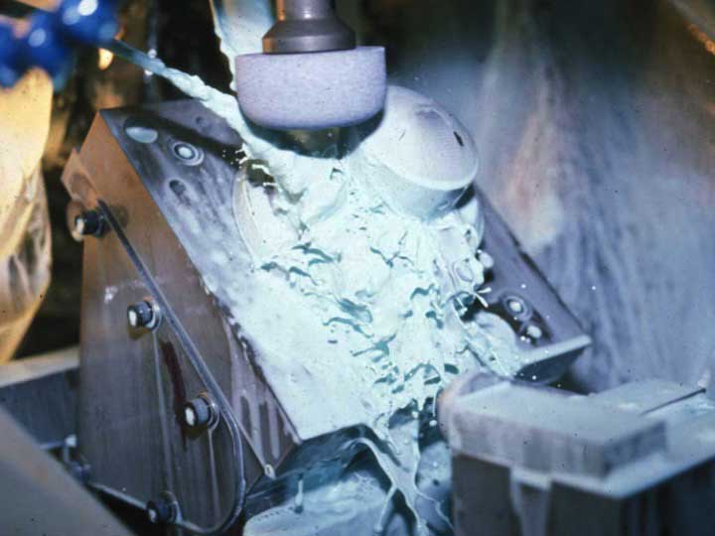
Notes:
33. We ground the freeform molding tool for the concave mirror with a newer commercial machine that had five axis computer control.
.

Slide 34
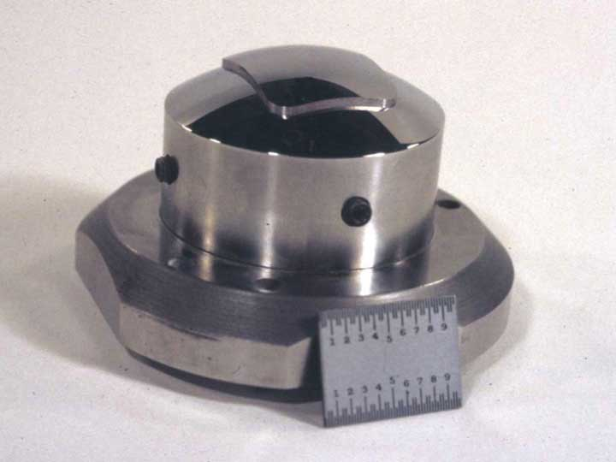
Notes:
34. Here is the finished mirror molding tool. The scale is 25.4 mm long.

Slide 35
Notes:
35. In 1991 Logan and Rich patented a generating machine that could start with a lens blank that was spherical on both sides, and then generate a lens with the convex side still spherical, but with progressive and prescription corrections all on the concave side. Their machine used a spherical cutter for either milling or grinding the surface.

Slide 36
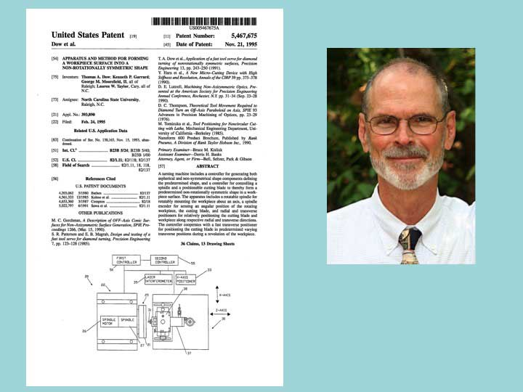
Notes:
36. In 1995 Tom Dow patented the use of a fast tool servo technique, using a stack of piezoelectric crystals to drive a cutting tool in synchrony with a blank rotation on a lathe. It produced a freeform optical shape, having no axis of symmetry.

Slide 37
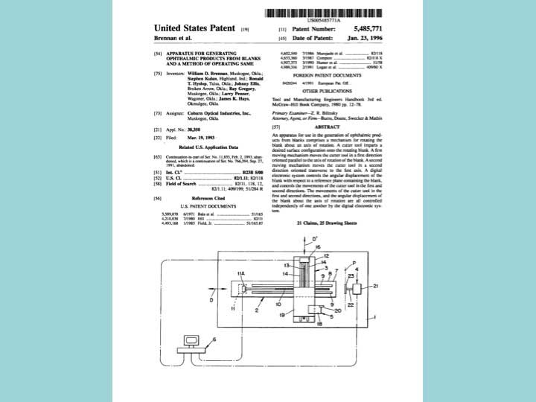
Notes:
37. In 1996 Brennan and several others patented an improvement on the Logan machine, using a diamond point to produce a smoother freeform optical surface

Slide 38
Notes:
38. In 1998 the Schneider company introduced a commercial machine, the HSC 100, capable of making a freeform spectacle lens in a two step process. First it milled a plastic blank with a toroidal cutter, then it produced the desired optical surface by turning it with a diamond point.

Slide 39
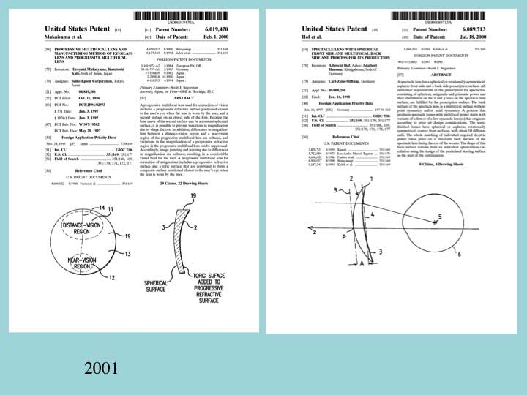
Notes:
39. In 2000 similar patents were issued to both Seiko and Zeiss, for once again designing and making a spectacle lens with a convex spherical front surface, and a freeform back surface that combined progressive power with the prescribed corrections for the wearer’s eye. Each of these U.S. patents had a European equivalent, and in both cases they were later revoked on the basis of prior art, including the Kanolt and the Logan patents.

Slide 40
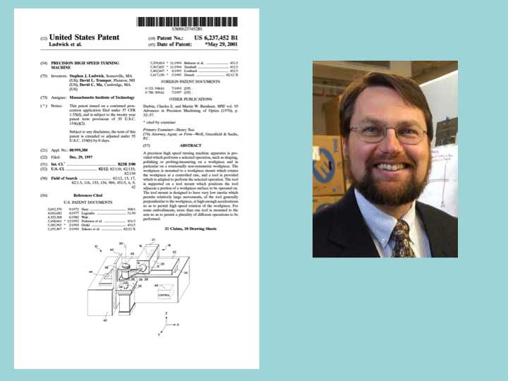
Notes:
40. In 2001 Prof. Dave Trumper and his group at MIT patented a high speed turning machine for producing a freeform lens surface.

Slide 41
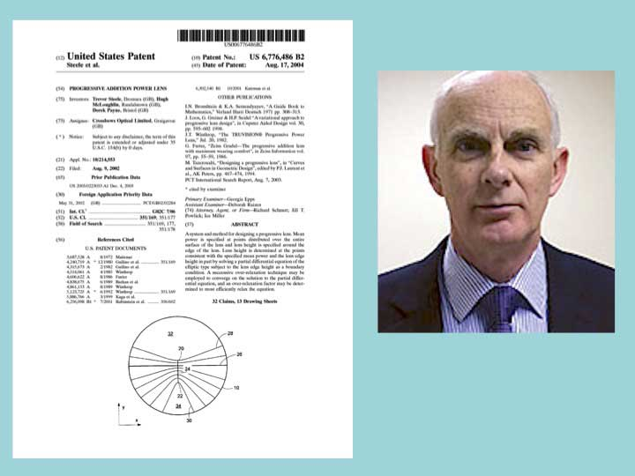
Notes:
41. Eyeglass surface designs continued to evolve. In 2004 Trevor Steele and others at Crossbows Optical in Northern Ireland patented an unusually efficient mathematical approach for designing a progressive spectacle lens surface.

Slide 42
Notes:
42. Aside from these uses in spectacle lenses, several inventors realized that freeform optical surfaces could be used in pairs to change the power of a spectacle lens or to adjust the focus in a camera or other instrument.

Slide 43
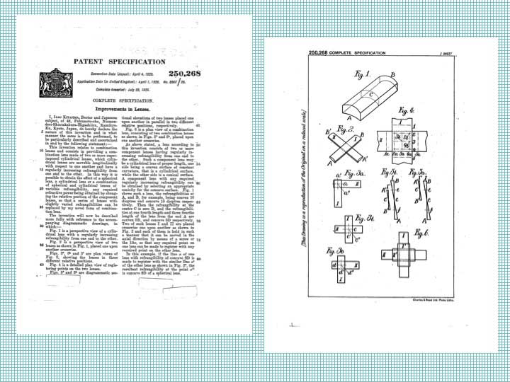
Notes:
43. In 1926 Kitajima, a physician living in Kyoto, received a United Kingdom patent for a scheme for changing focus in a continuous way, by moving two optical objects laterally, across each other. The objects he disclosed were not yet freeform, but were each made by pairing two slightly tapered cylindrical lenses, placed crosswise to each other. The combination of the two cylindrical lenses was equivalent to a single freeform lens.

Slide 44
Notes:
44. In 1992 I had an opportunity to visit Kitajima’s old neighborhood in Kyoto. We easily found it from the information in his UK patent.

Slide 45
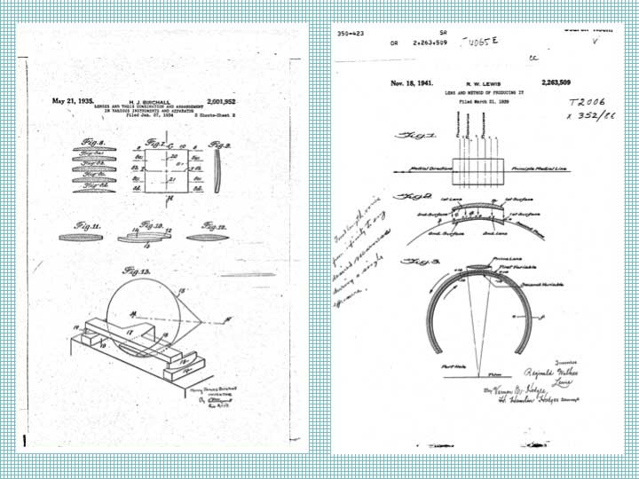
Notes:
45. Birchall in 1935 and Lewis in 1941 received patents for versions of Kitajima’s invention that used progressive freeform surfaces instead of paired tapered cylinders.

Slide 46
Notes:
46. Luis Alvarez, a well known physicist, received a patent in 1967, essentially for describing the Lewis lens with a cubic equation.

Slide 47
Notes:
47. In 1971 Jim Baker received a patent for a variable power lens with two sliding freeform parts that improved on the Alvarez lens by including fifth-power or higher order algebraic terms to gave better control of spherical aberration.

Slide 48
Notes:
48. In 1984 Baker received a patent for disclosing how two freeform lenses can be included within a photographic lens for adjusting its focus.

Slide 49
Notes:
49. While we realized that freeform surfaces could be used to focus a camera, we also understood that a pivoted motion would be much easier to manufacture than the kind of sliding motion that has been mentioned. Jim Baker and I received a patent on this idea in 1987.

Slide 50
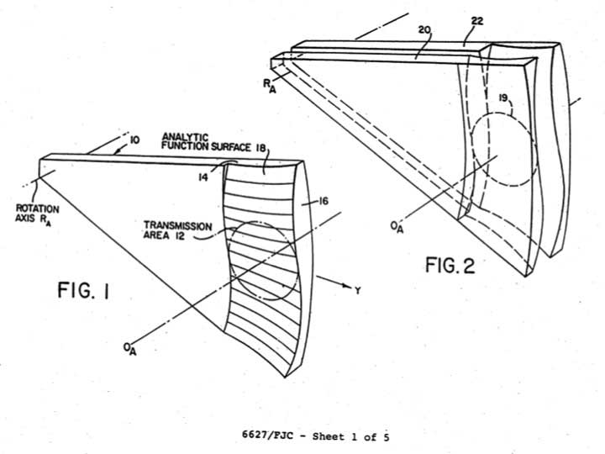
Notes:
50. We used two freeform surfaces together, one of them moved with a pivoting action across the optical aperture of a lens. The pair will change the dioptric power without introducing coma.

Slide 51
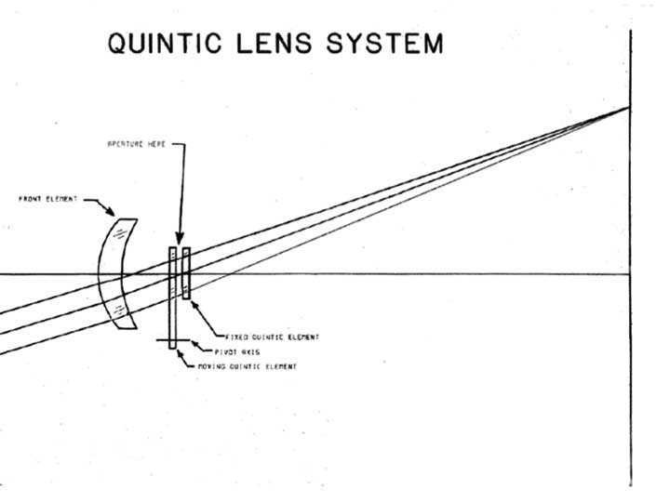
Notes:
51. Here is the optical path of the Polaroid Spectra camera we introduced in 1986, beginning with an aspheric meniscus lens on the left. There is a thin mechanical shutter between the small moving lens and the small fixed lens. We called this freeform shape a “Quintic” because our early designs used a fifth-order polynomial description. (Later we used seventh-order polynomials, and higher, but didn’t want to change to the name “Septic”.)

Slide 52
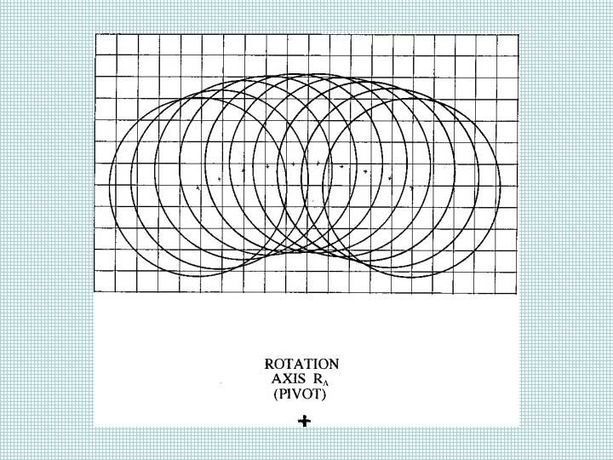
Notes:
52. Our Spectra camera design gave us ten zones of focus, but used a compact moving part that was only about two and a half apertures wide. The ten zones were selected automatically by using sonar to measure the subject distance.

Slide 53
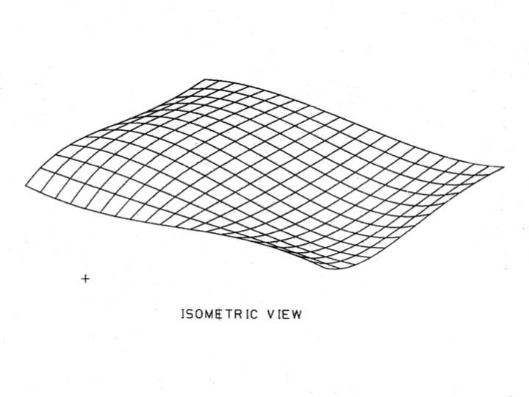
Notes:
53. This is the shape of the moving freeform surface.

Slide 54
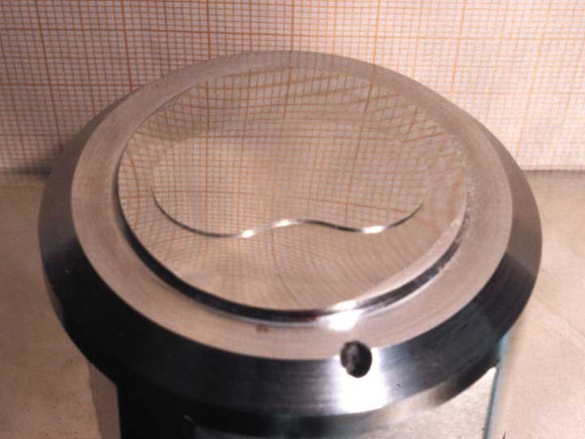
Notes:
54. Here is a freeform molding tool after it was ground and polished.

Slide 55
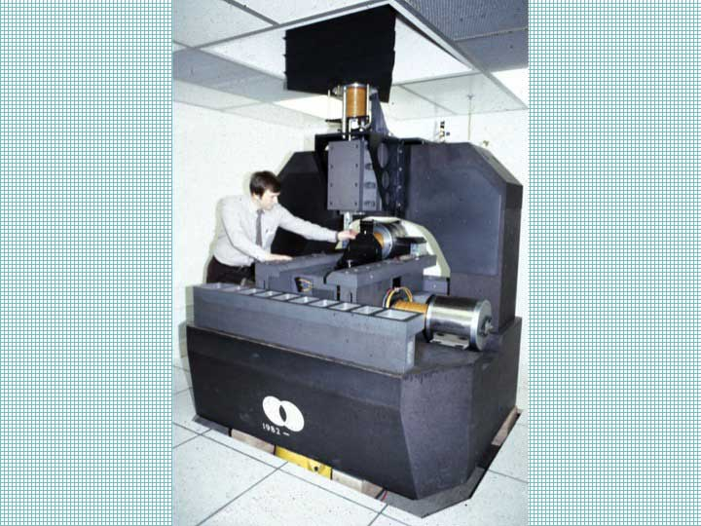
Notes:
55. After 1982 we used a home-built profilometer with even greater precision, better than 20 nanometers. This machine was built of granite with air-lubricated slides, linear magnetic motors, and laser interferometer control. The triangular structure at the top is a flotation tank that supported the weight of the vertical axis components. This profilometer had a working volume of about 15cm by 15cm by 30cm.

Slide 56
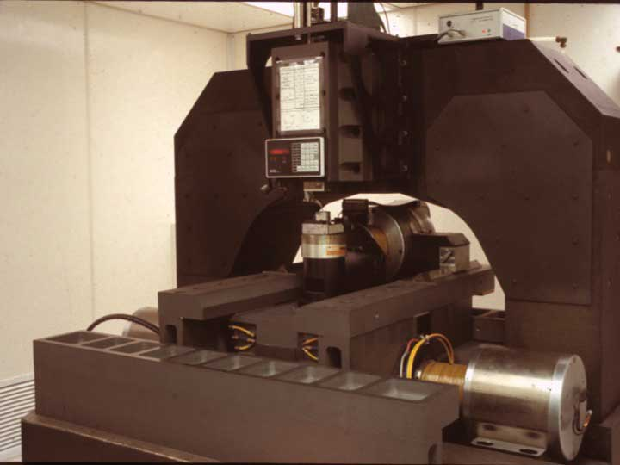
Notes:
56. Here is a closer view of the machine

Slide 57
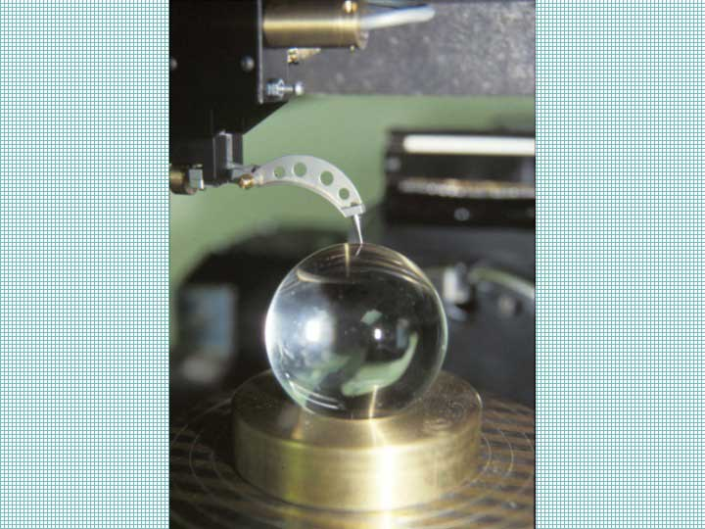
Notes:
57. We used a tiny ruby ball to contact the optical surfaces. Here it is contacting a large glass sphere we used for calibration.

Slide 58
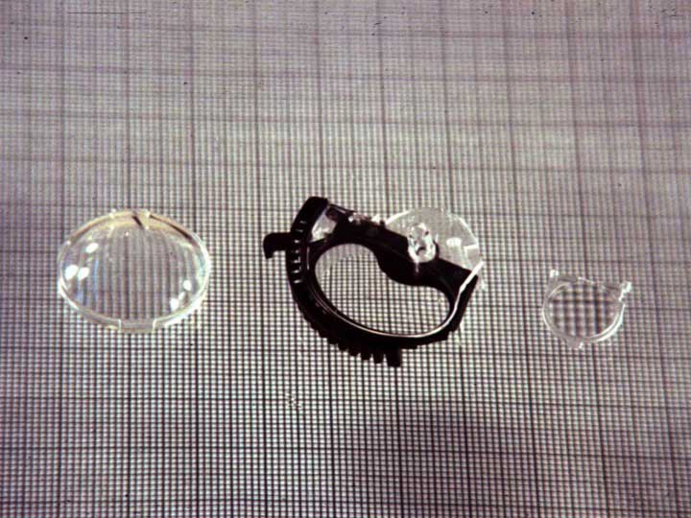
Notes:
58. These are the molded optical parts for the Spectra camera: the aspheric meniscus taking lens, the moving Quintic freeform focus lens, and the fixed Quintic freeform lens.

Slide 59
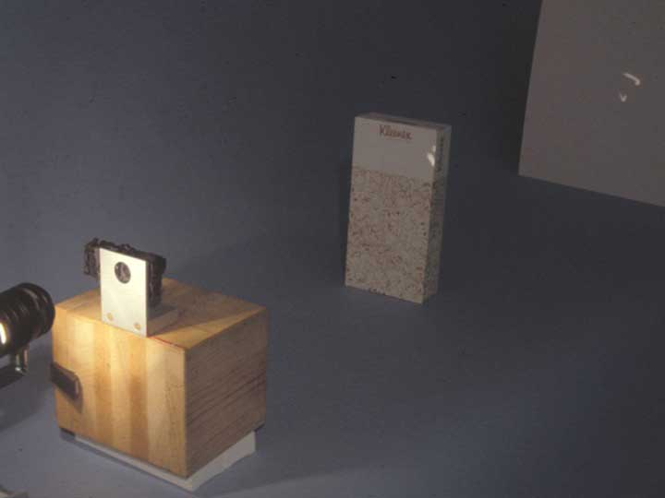
Notes:
59. In this demonstration the assembled camera lens is making the image of a lamp filament, on the left, onto a distant white screen, on the right.

Slide 60
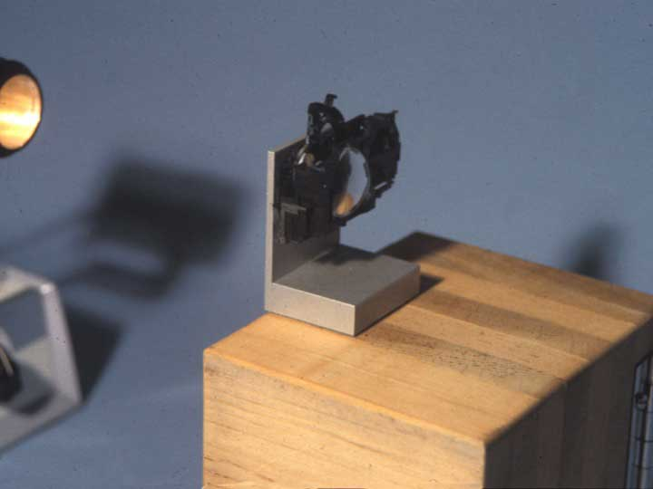
Notes:
60. Here the moving Quintic shape has been rotated upward to change the focus by about 1.5 Diopters.

Slide 61
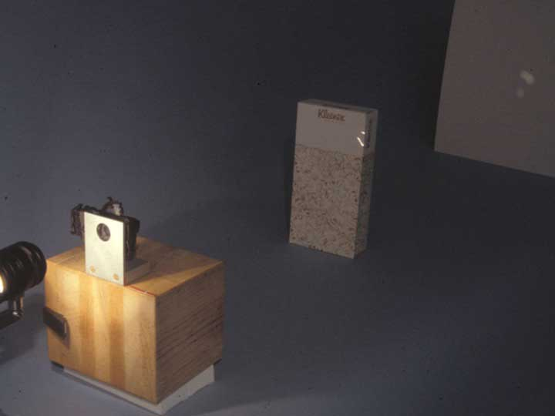
Notes:
61. Now the lamp filament is in focus on the nearby cardboard box. Without the use of the moving freeform shape, this same focus change would have required moving the camera lens nearly 3cm farther from the lamp.

Slide 62
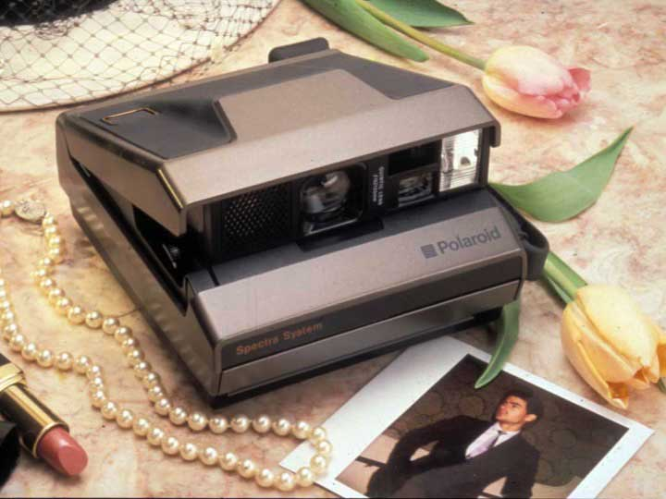
Notes:
62. The finished Spectra camera was first sold in 1986. Several million of them were made.

Slide 63
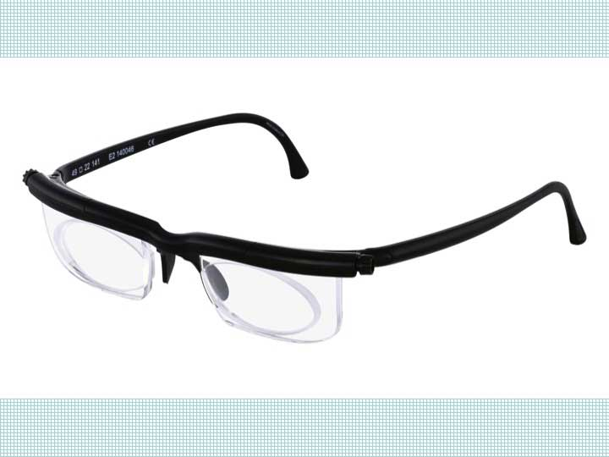
Notes:
63. The Alvarez two-part adjustable lens has been used commercially in eyeglasses since about 2005, by the Adlens company.

Slide 64
Notes:
64. Freeform lenses cannot be made with the same methods that produce spherical optical surfaces, or even rotationally symmetric optical surfaces.

Slide 65
Notes:
65. Molded freeform lenses cannot be checked for quality with simple interferometric test plates, the way we can check spherical lenses. But Steve Fantone realized that they can be checked easily with an interferometer containing a hologram, and that the hologram we needed could be generated optically from the freeform molding tool itself.

Slide 66
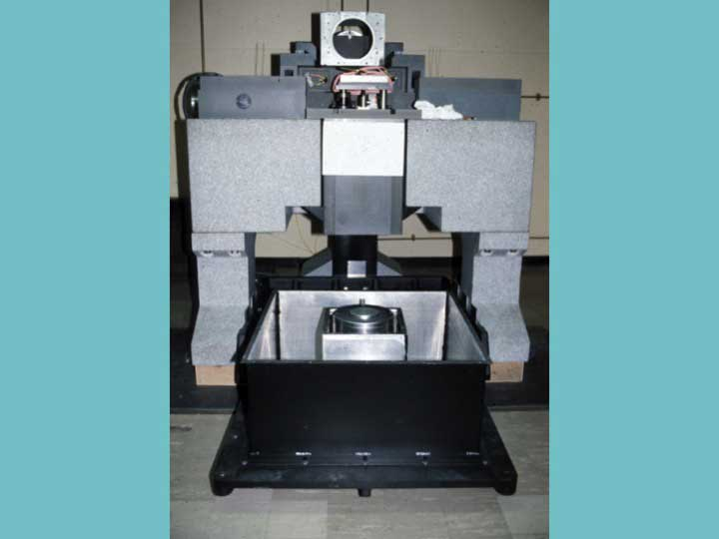
Notes:
66. In 1994 we built another big granite machine, this time capable of grinding freeform optical shapes. Again, we used air bearings, air slides, linear magnetic motors, and laser controls. This machine measured about 1.5 meters in each dimension.

Slide 67
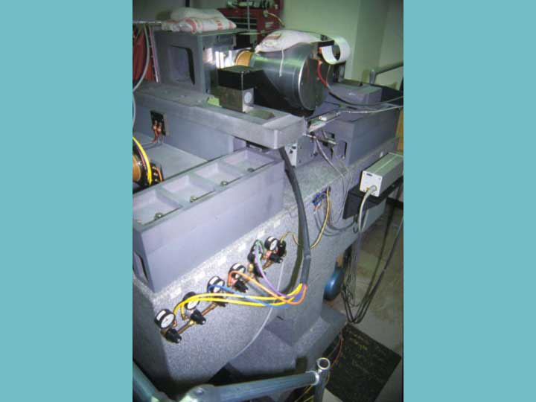
Notes:
67. The air for lubricating the slides was controlled to different pressures at different locations on the slides.

Slide 68
Notes:
68. This machine was operated in a temperature controlled room.

Slide 69
Notes:
69. Here is where the grinding tool, near the center, contacts the surface that is to be shaped. The vertical spindle on the left was used to give the grinding tool an accurate shape whenever we corrected it for wear.

Slide 70
Notes:
70. This freeform Quintic optical shape was ground on that machine. The surface quality was so good that it did not require polishing after the grinding.

Slide 71
Notes:
71. A laser reflection from the ground tool shows faint diffraction orders from the small periodic irregularities on the ground surface.

Slide 72
Notes:
72. An image taken with a special photon tunneling microscope shows that the irregularities left after grinding were about 1/10 micron deep, or about 1/4 of a wavelength of light. That is about 100 nanometers. Notice that the vertical scale is much finer than the horizontal scale in this expanded view.

Slide 73
Notes:
73. This enlarged model of the moving Quintic surface shows its form.

Slide 74
Notes:
74. Most of our work with freeform surfaces used polynomials of fourth, sixth, or ninth degree to describe them, giving the Z coordinate as a function of the X and Y locations raised to various powers. But a freeform surface can also be described with any precision needed by using standard Zernike Polynomials, as many as necessary for a particular design. Here are examples and illustrations of the first fifteen Zernike terms. Zernike polynomials were introduced in 1934.

Slide 75
Notes:
75. An entirely different use for a freeform lens is to increase the depth of field of a digital camera.

Slide 76
Notes:
76. This idea was patented by Tom Cathey and Ed Dowski in 1998. A freeform “phase plate” near the aperture of a camera lens will degrade the Modulation Transfer Function at the image, but in a way that is the same over some range of defocus. A standard correction process can then restore the image quality over that extended range.

Slide 77
Notes:
77. Here is one freeform shape used by Cathey and Dowski for wavefront coding.

Slide 78
Notes:
78. Tom Cathey received a patent in 2006 for applying this wavefront coding idea to the human eye, where the freeform surface can be applied to a contact lens or to an implanted lens used for cataract surgery. The result even without digital computation is vision that can be acceptable for both distance and for reading, over a range of at least three diopters.

Slide 79
Notes:
79. Freeform lenses can be used in the infrared as well, where plastic and glass are not transparent.

Slide 80
Notes:
80. Here is a way to make freeform lenses for use across the infrared spectrum by an inexpensive molding process, rather than by machining each one. This patent discloses the use of pressure alone to mold a finished lens by consolidating tiny crystalline particles of a desired material, such as potassium bromide or cesium iodide.

Slide 81
Notes:
81. A commercially available hand press can be used to make a progressive optical surface with these materials.

Slide 82
Notes:
82. Here are the parts of a compression cell used with the tool.

Slide 83
Notes:
83. Here the compression cell is assembled, using a US twenty-five cent coin for one side of it.

Slide 84
Notes:
84. This coin was used for the example because George Washington’s cheek has a freeform shape. In addition, the curls of his hair show that the method can be used to manufacture arrays of small lenses, and some random scratches show that diffractive optical surfaces can also be replicated this way.

Slide 85
Notes:
85. This photograph shows the potassium bromide pressing by reflected light.

Slide 86
Notes:
86. This photograph shows the pressing by transmitted light.

Slide 87
Notes:
87. Infrared images can show human subjects by their own thermal radiation, and have been used in automobiles to reveal pedestrians hidden by fog.

Slide 88
Notes:
88. Infrared images are also used to evaluate hot areas on automobile engines and on electronic circuit boards.

Slide 89
Notes:
89. In this design example, an infrared lens made with two aspheric germanium components is compared with a nearly identical lens made with two spherical germanium components, with the help of a molded aspheric component pressed from potassium bromide, for equivalent performance at a much lower cost. If it is desired, the potassium bromide component can be made with a freeform surface for the wavefront coding technique.

Slide 90
Notes:
90. Molding pressure can be applied to the powder in a simple press.

Slide 91
Notes:
91. The mold surfaces can be freeforms if desired, and the lens can be molded directly into its mounting cell as part of the press.

Slide 92
Notes:
92. Here are additional lens components assembled into the same mounting cell that was used for the molding press.

Slide 93
Notes:
93. Potassium bromide is transparent for wavelengths out to about twenty microns in the infrared, spanning the entire eight to twelve micron range generally used for thermal imaging.

Slide 94
Notes:
94. If more wavelength range is needed, cesium iodide can be used even out to forty microns.

Slide 95
Notes:
95. A large commercial press like this can be used to make pressed infrared lenses of much greater size.

Slide 96
Notes:
96. Freeform optical surfaces can now be made by 3D printing as well, in a surprising development by BMF Material Technology.

Slide 97
Notes:
97. Nick Fang, an MIT professor and co-founder of BMF, is an inventor of the new 3D printing method for making lenses. He and his team developed a technique called projection micro-stereo-lithography. It is a parallel optical 3D micro/nano fabrication technique. 97. This process fabricates 3D microstructures by cross-linking liquid photopolymers, layer-by-layer, using images generated by a digital data projector. By sequentially presenting the slice images on the digital screen, intricate 3D microstructures, having resolution of a few micro-meters, can be readily constructed as stacks of solidified polymer.

Slide 98
Notes:
98. This 3D printing work started with production of complicated mechanical structures of sub-millimeter sizes, with micro-meter precision. But then the technique has been applied for making lenses. The 3D printing method with this high precision can be used to make a large number of small structures at one time, or can make larger objects such as spectacle lenses.

Slide 99
Notes:
99. Now 3D printing can be used to produce aspheric lenses or any kind of combined lenses with complete design freedom. It can produce modern spectacle lenses that include a freeform progressive shape for correcting a wearer’s presbyopia. This large-area additive manufacturing technique can be scaled up for volume manufacturing.

Slide 100
Notes:
100. Professor Fang will describe his 3D lens printing work in the next presentation here this afternoon..

Slide 101
Notes:
101. [Thank you]

