Slide 1
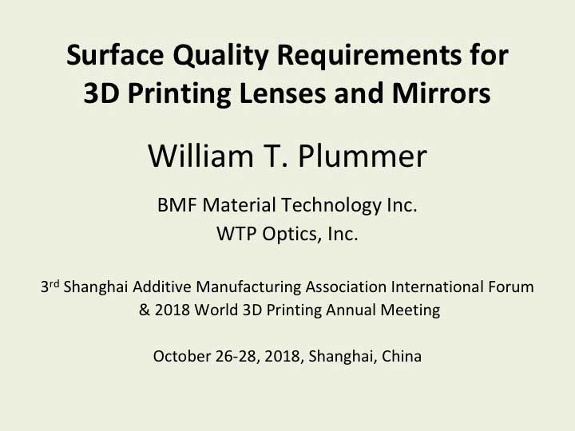
Notes:
1. With improvements in 3D printing we can now make optical components of various kinds, but these may require high quality surfaces that stretch the technology.

Slide 2
Notes:
2. Fabricating lenses and mirrors by 3D printing requires new considerations for defining and measuring the surface quality. A special optical device provides a way to make controlled variations in wavefront errors at a surface, to explore the practical requirements, starting with the classic Rayleigh quarter-wave criterion.

Slide 3
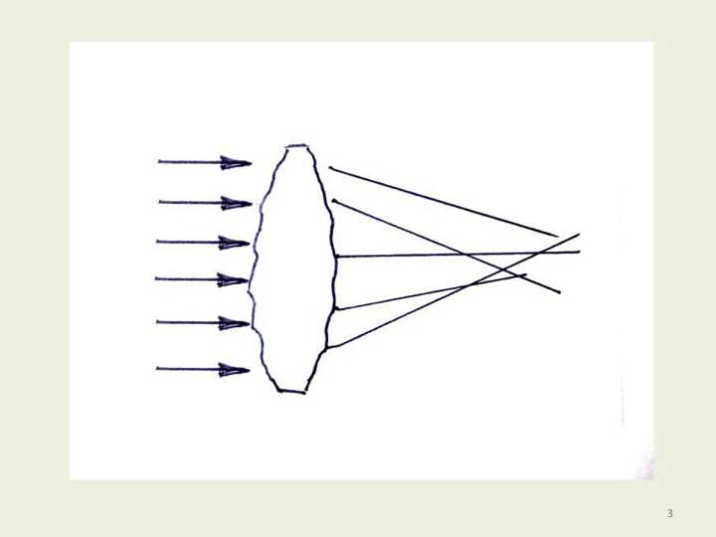
Notes:
3. Irregularities on a lens surface caused by the small steps produced in the 3D printing process will affect the way light passes through the surface and may detract from image quality.

Slide 4
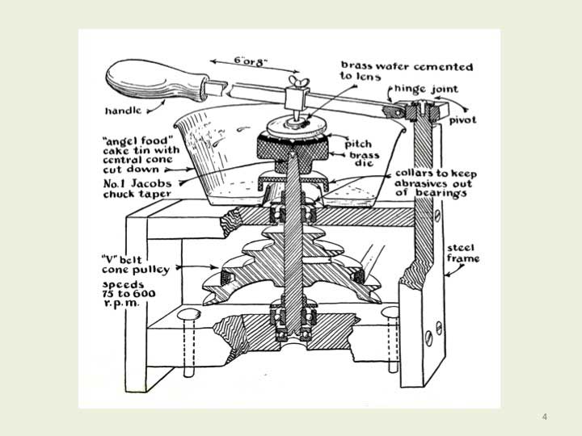
Notes:
4. Spherical optical surfaces can be smoothed and polished by moving them against a matching shape in a nearly random manner. This method has been used for more than 400 years, but it is limited to making spherical surfaces.

Slide 5
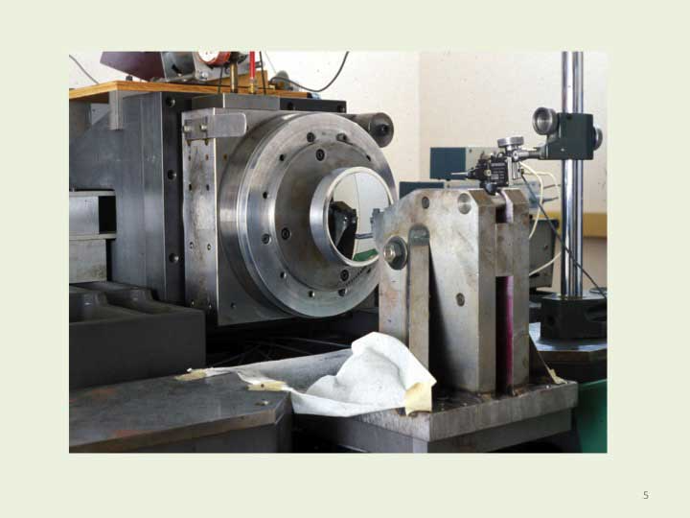
Notes:
5. Non-spherical shapes with an axis of rotational symmetry can be made by diamond turning on a special lathe. Before lathes of this quality were available, rotationally symmetric aspherical surfaces were made by careful manual corrections and repeated testing.

Slide 6
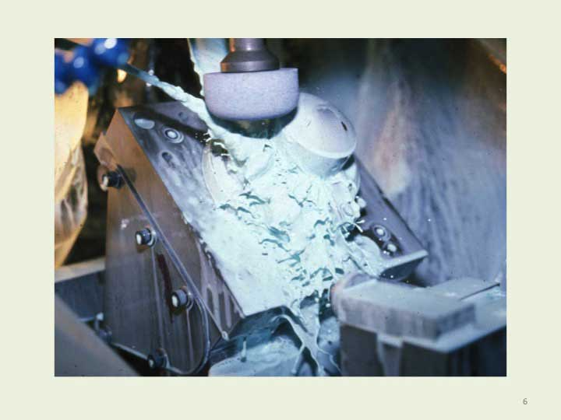
Notes:
6. Non-spherical shapes without an axis of rotational symmetry, called free form, may require precise three dimensional grinding or milling by computer control on special machinery, or the use of a diamond-turning lathe with a synchronized fast tool servo motion. Free form shapes are most commonly used on spectacle lenses with a progressive surface power. They are also used in some cameras and optical instruments. Free form shapes can now be made much more economically by 3D printing.

Slide 7
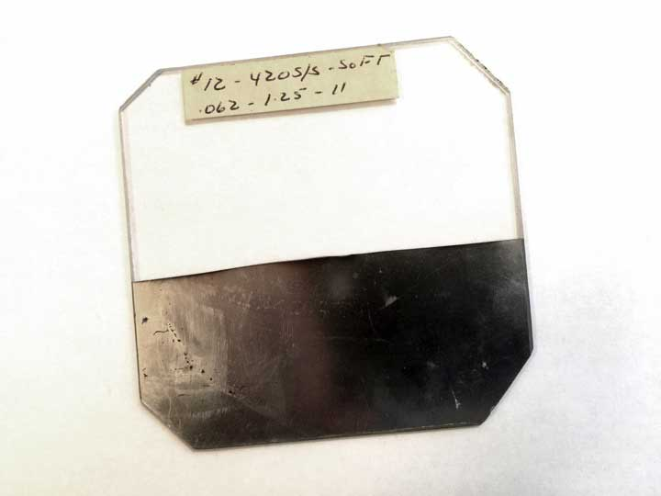
Notes:
7. How good does a 3D printed optical surface have to be? To develop 3D printing without a polishing step, a simple optical device in the form of a textured flat plate can be used to understand and explore the functional impact of surface irregularities. This acrylic plate is about 8 cm square. Half of the textured side is coated with reflective aluminum. The surface texture is about one half wavelength deep. Its optical action can be adjusted easily to explore what surface quality is needed for a particular application.

Slide 8
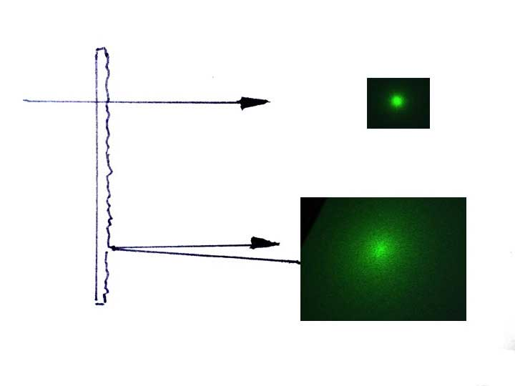
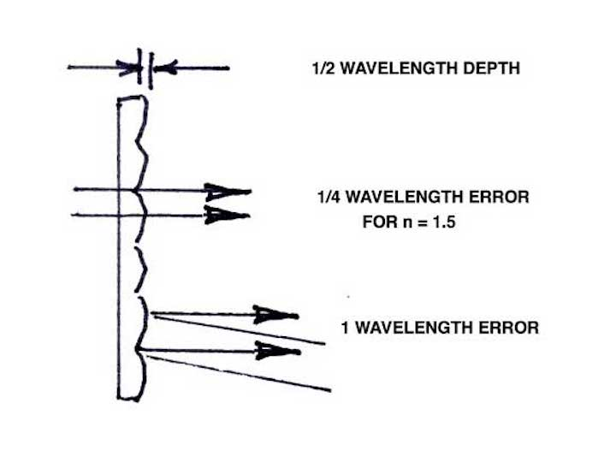
Notes:
8. If the surface texture structure is one half wave deep, about 300 nanometers, the affect on transmitted light will depend on the refractive index. With an index of 1.5 the resulting wavefront error will be about one quarter wave, or 150 nanometers. For reflected light the error is twice the surface depth, about one full wavelength, or 600 nanometers. Reflected light will follow the principles of geometric optics, and the angular scattering will depend on the slopes of the surface irregularities. Mirror surfaces are more difficult to fabricate than lens surfaces, by this factor of four.

Slide 9
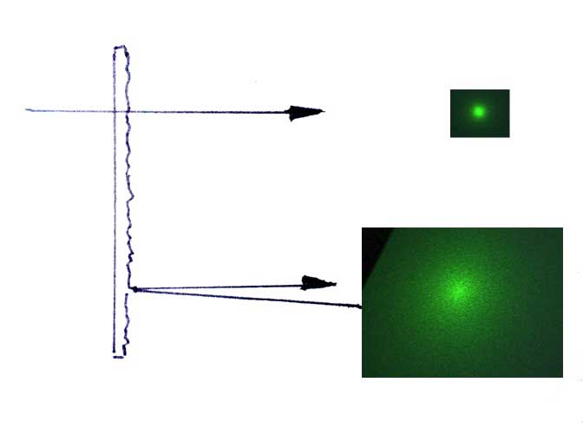
Notes:
9. A textured surface will have very different affects on transmitted light and reflected light. This example shows how reflected light may be greatly scattered by the same surface that has little effect on transmitted light.

Slide 10
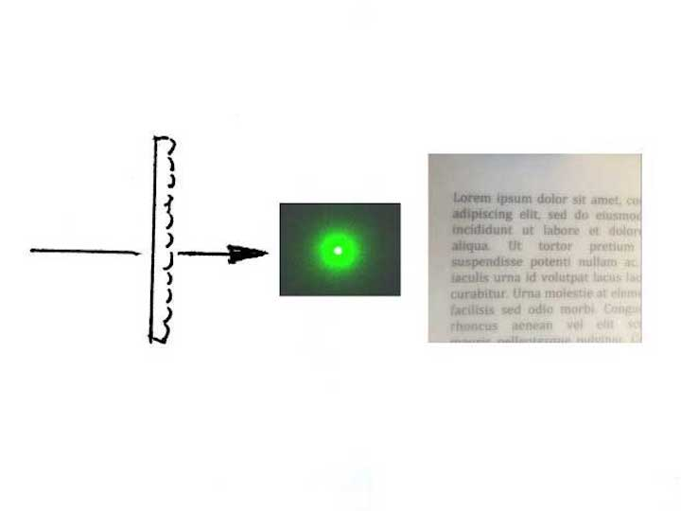
Notes:
10. We can compare surfaces by evaluating the spread of a laser beam, or by viewing printed text through each surface. In the case of quarter-wave errors, recognized by Rayleigh in the late nineteenth century as giving a fairly good image, the transmitted light shows traces of a sharply resolved image, but may still be degraded in appearance. In this example we see that the Rayleigh Criterion may not give a good enough image for many applications.

Slide 11
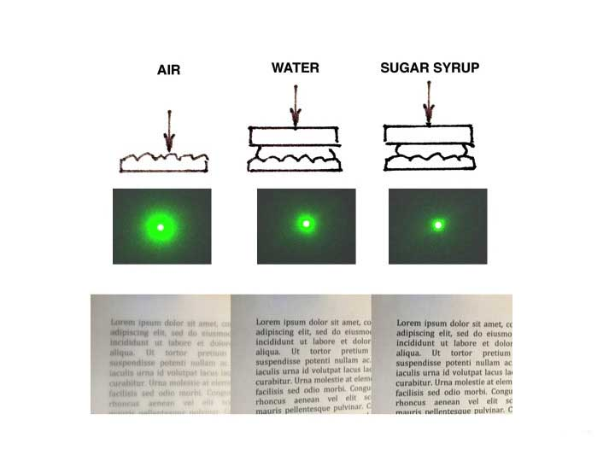
Notes:
11. We can adjust the impact of these particular surface errors by immersing the irregularities in a liquid. Water reduces their effect, because the wavefront variation depends on the difference of the relative refractive index of the irregularity and its surround. In this case the plate has an index of 1.492 and the water has an index of 1.333. The ratio of (1.492-1.333)/(1.492-1.0) is about 1/3, and we see this improvement in the image.
There is a significant image improvement, but probably not enough for a demanding application, even with an improvement of the factor of three beyond the Rayleigh Criterion. When immersed in a sugar syrup with a matching index the irregularities can be made to vanish, showing the image quality that will be available with perfect surface smoothness.

Slide 12
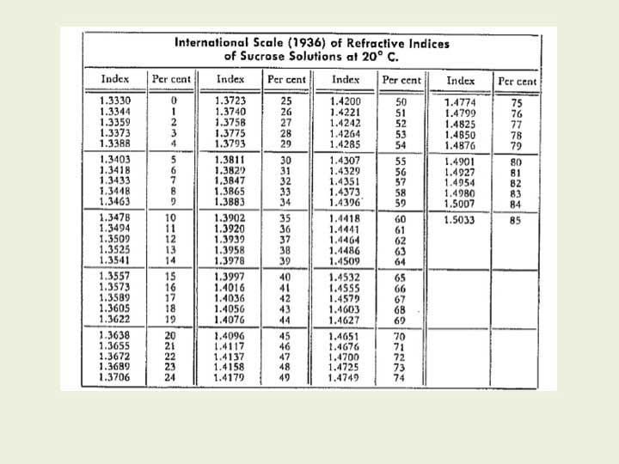
Notes:
12. This table shows that by diluting the sugar solution we can easily produce any refractive index from 1.333 of pure water to an exact match to the 1.492 of the plastic plate. The perfect match requires just more than 80% sugar concentration. In this way we can explore the effect of surface errors in the entire range. We can evaluate the optical effect of any particular surface error even before making a final 3D printed lens.

Slide 13
Suggested Development Procedure:
1. Evaluate the quality of a prototype 3D printed lens.
Combine a conventional lens with the textured plate and
adjust the sugar solution to match the same quality.
3. Adjust the sugar solution to produce the desired quality.
Compare the solution refractive indices to judge what
surface smoothness improvement is needed in proportion
to the solution index differences from the plate index.
Notes:
13. First test an early prototype 3D printed lens. If it is not good enough, replace it by a conventional lens and combine it with the textured plate. Use a sugar solution with the plate and adjust its index to match the quality of the prototype. Then raise the index of the sugar solution so that the combination gives the desired quality. The needed surface smoothness improvement is the ratio of the differences between the two solution refractive indices and the plate index.

Slide 14
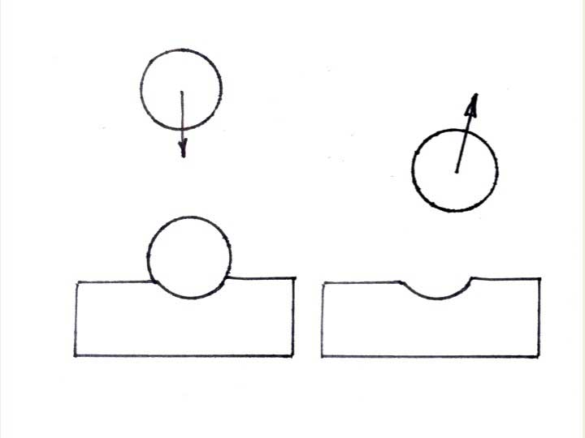
Notes:
14. The special optical device I have illustrated was made by a mechanical technique. When a hard spherical ball bearing is dropped onto a stainless steel surface, polished but not hardened, it can make a dent. The dent remains as the ball bounces away. We found that uniform dents can be made by dropping many balls onto the metal surface from the same height.

Slide 15
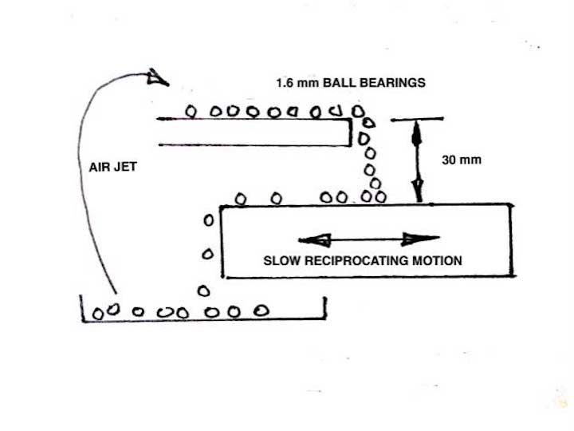
Notes:
15. We achieved a uniform random texture of about a half-wavelength depth by experiment, by dropping ball bearings of 1.6 mm diameter just 30 mm onto the surface. Any individual dent may be hard to see, but with the arrangement shown we provided several hundred balls, rolling off of a shelf 30 mm above the surface, and used a simple mechanism to move the metal surface back and forth under them as they fell. The bouncing balls rolled off of the dented surface, were collected in a tray, and were returned to the higher shelf by an air jet. After about 20 hours of this process the metal surface had a uniform appearance. A surface like this can be made in many other ways, such as by airbrush spraying a glass plate with a polymer dissolved in a volatile liquid, airbrushing a flat plastic plate with tiny droplets of a solvent, or even by 3D printing the desired structure.

Slide 16
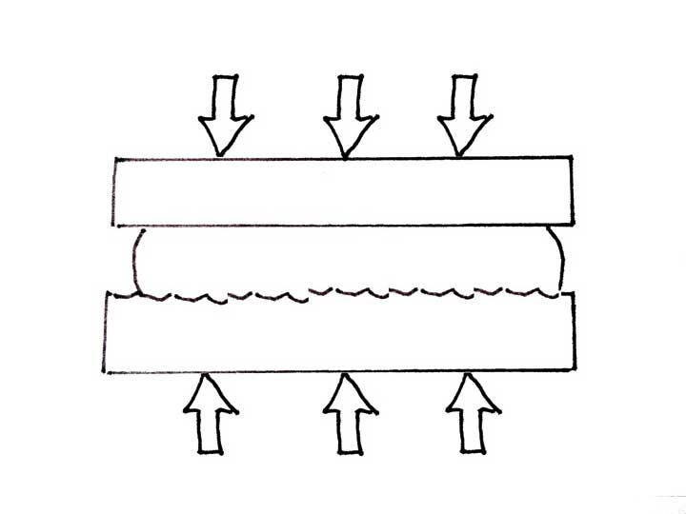
Notes:
16. This dented surface and a matching flat surface were held in a heated press to transfer the surface structure to a sheet of acrylic plastic for making the optical texture we wanted. Of course, this method can be used to make any deeper or shallower texture that may be needed for a particular tolerance study, and the effect can then be fine tuned by the use of different sugar concentrations.

Slide 17
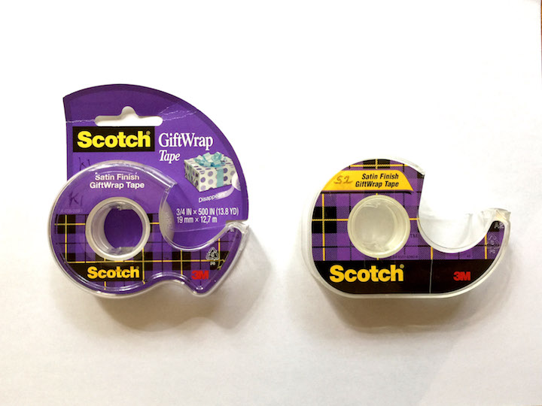
Notes:
More recently I have found commercial products that can be used in this same way for exploring optical quality. These special tapes made by the 3M company are used for wrapping gift packages, because the tape is nearly invisible on the wrapping paper. The example on the left is their current product. The one on the right was made several years ago and has a much deeper and generally more useful surface texture.

Slide 18
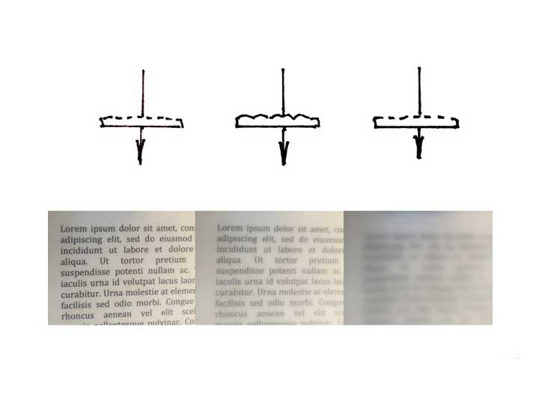
Notes:
Here my original textured plate is in the middle. The optical effect of the newer tape product is weaker, on the left, and the other is stronger, on the right. The stronger sample would be excellent for use with the variable sugar solution for modeling optical surface tolerances, but now is hard to find.
Other commercially available materials may also be useful. A good example is the kind of diffusely textured glass sheet that is sold for use in picture
frames, to remove reflected glare.

Slide 19
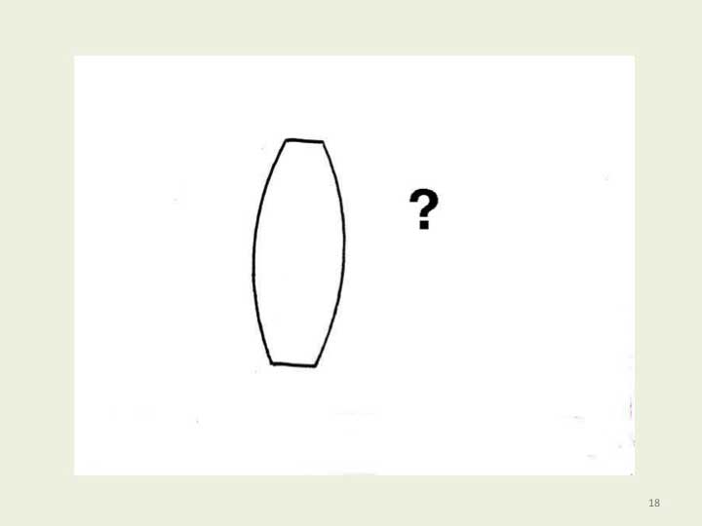
Notes:
19. The result we desire is a way to understand how much better than the Rayleigh criterion a surface must be for a particular application, so that a 3D printing process can be arranged to meet that need.
Post-processing of 3D printed optics has been used to finish the surfaces, including flame polishing, solvent vapor polishing, fluid-jet polishing, manual polishing, or surface coating.

Slide 20
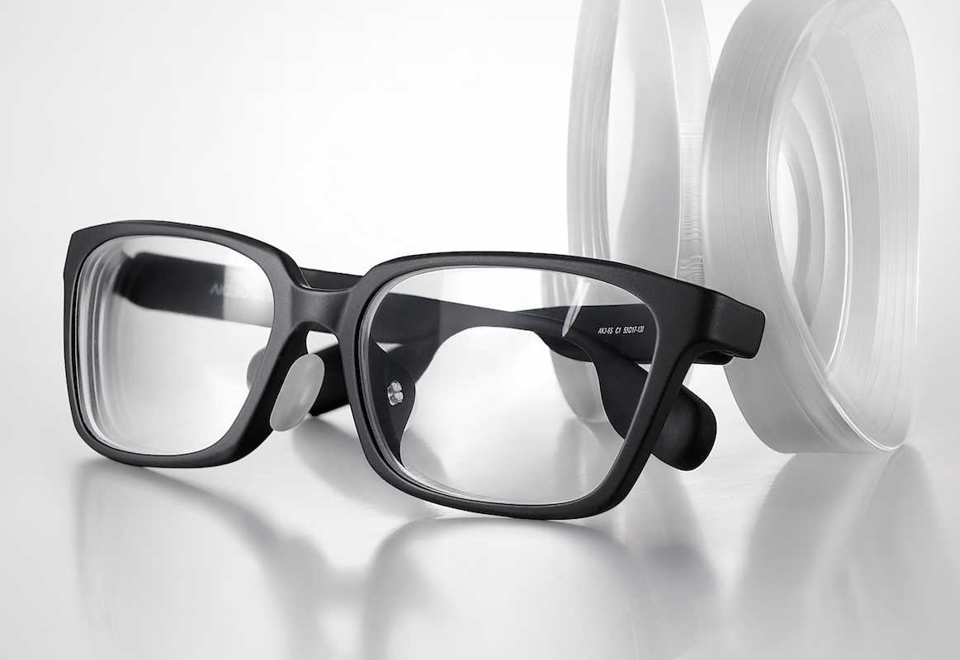
Notes:
20. A number of methods have also been developed for achieving an optically smooth printed surface without the need for later polishing, many of them still proprietary, and I expect to find 3D printed lenses and possibly even mirrors being made for many applications.

Slide 21
Notes:
21. Thank you!

